Slide 1
Taxi Trip and Fare Data Analysis
The B Team
Jinali Sheth
Kuldeep Mahaveer
Rajesh Jorigal

Slide 2
Previously
We showed 10 busiest pickup and drop off locations and mentioned how a large portion of data has ‘0.0’ location.
Now we take a closer look at its reason.

Slide 3
Finding 1
589 taxis did not have GPS working throughout the year
They contributed to 92545 rides that year.
Number small because majority of these taxis had only 2 or 3 trips per month.
But

Slide 4
Additionally 86826 records did not have pickups recorded and
188724 records did not have dropoffs recorded
To learn more...

Slide 5
Most of these unrecorded locations were in Manhattan.
This was because of GPS signals scattered by tall buildings.

Slide 6
Finding 2
Total rides in 2013 = 173,179,771
Total rides paid by Card = 93,334,004
Total tip data for rides paid by card = 90,450,929
Total rides paid in Cash = 79,110,096
Total tip data for rides paid in cash = 6708
So further analysis on tip amount was only done on Card data.

Slide 7
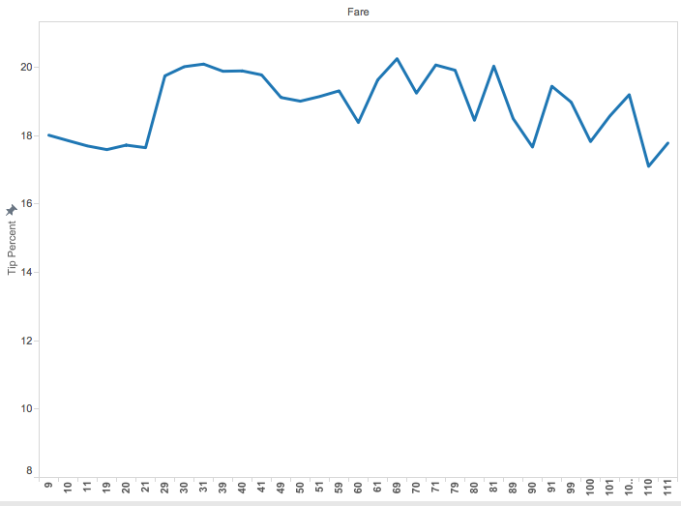

Slide 8
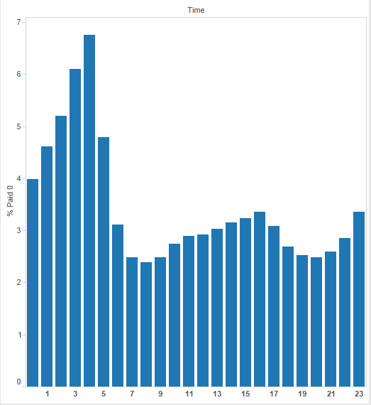

Slide 9
Finding 3
To get a bigger picture we took an average analysis of rides for each hour throughout the year
It looked something like this

Slide 10
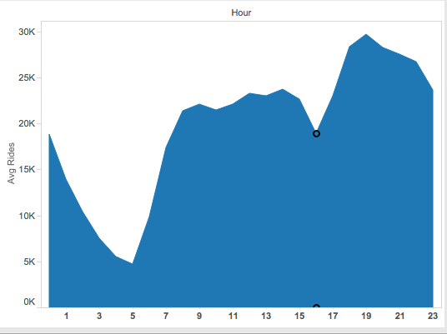

Slide 11
hour medall hack lic. diff. rides
0 8153 8153 0 15860
1 5184 5186 2 9125
2 3365 3364 -1 5689
3 2345 2346 1 3754
4 2177 2178 1 3300
5 2931 2934 3 4677
6 5904 5903 -1 12830
7 8738 8738 0 23984
8 9931 9934 3 27937
9 10385 10384 -1 26022
10 10367 10368 1 23580
11 10349 10353 4 23669
12 10321 10328 7 24170
13 10360 10361 1 23495
14 10398 10400 2 24834
15 9563 9598 35 22711
16 8072 8277 205 17646
17 9324 9388 64 23258
18 10746 10752 6 30720
19 11309 11313 4 33034
20 11381 11385 4 32652
21 11312 11315 3 32827
22 11009 11008 -1 31502
23 10706 10707 1 29101

Slide 12
Failed Attempts
NYPD Vehicle Collision data
Average time per day a driver is without a passenger.

Slide 13


